Slide 1
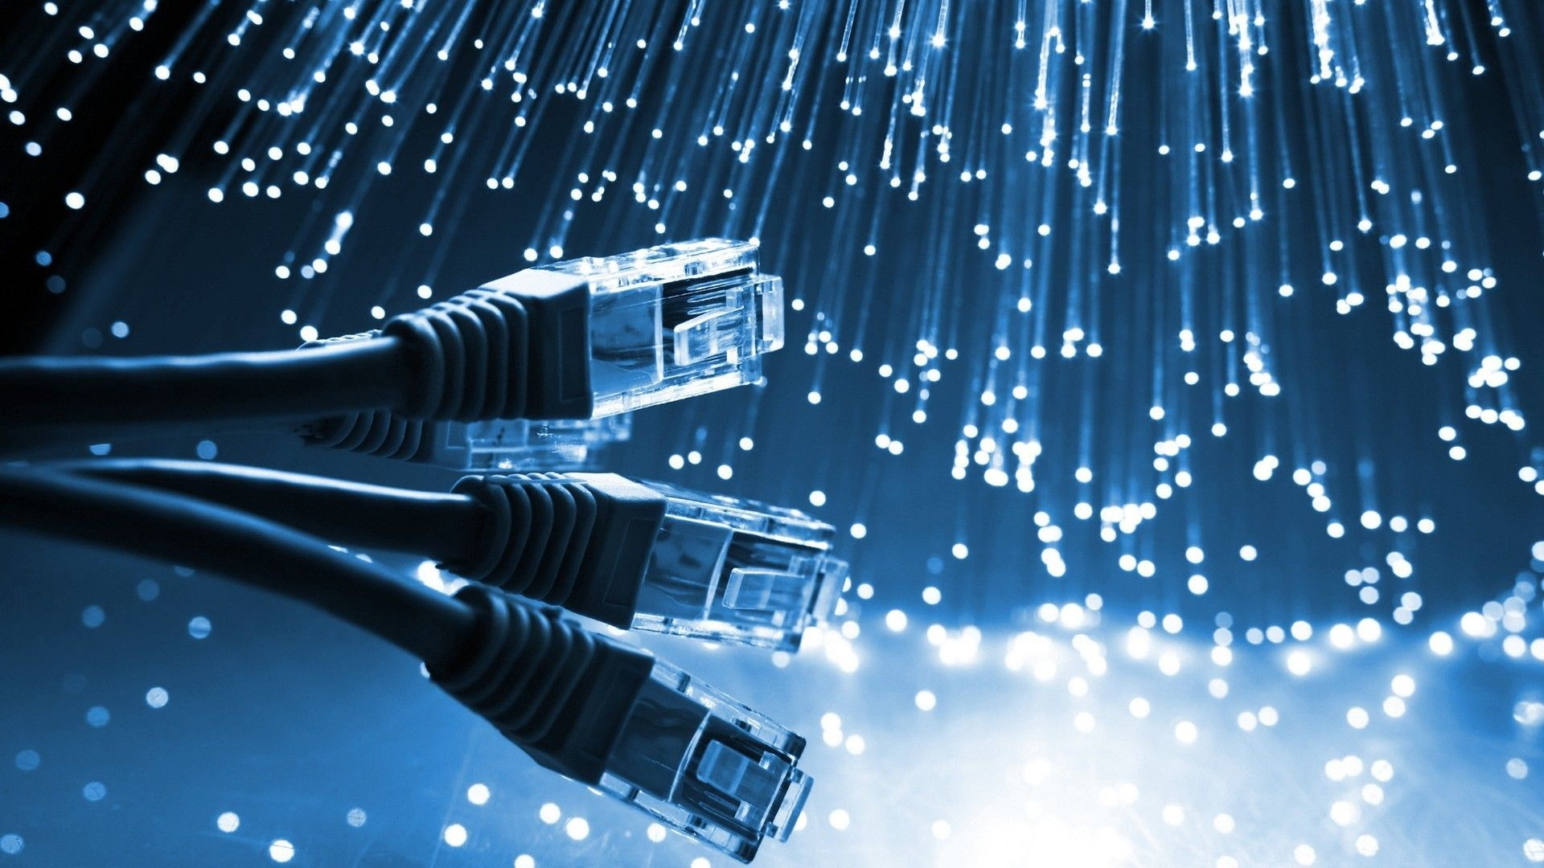


NETWORK DESIGN FOR
XYZ UNIVERSITY
MLB_WD_CSNE_01.01_09

Slide 2
TABLE OF CONTENT

Slide 3
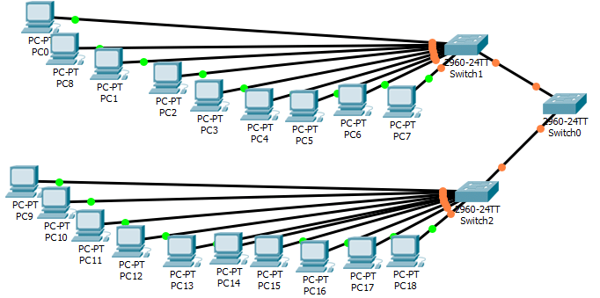
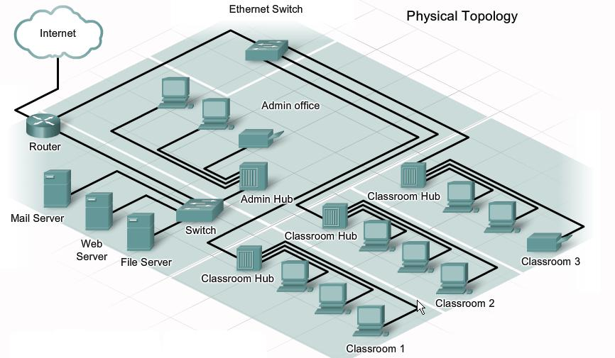
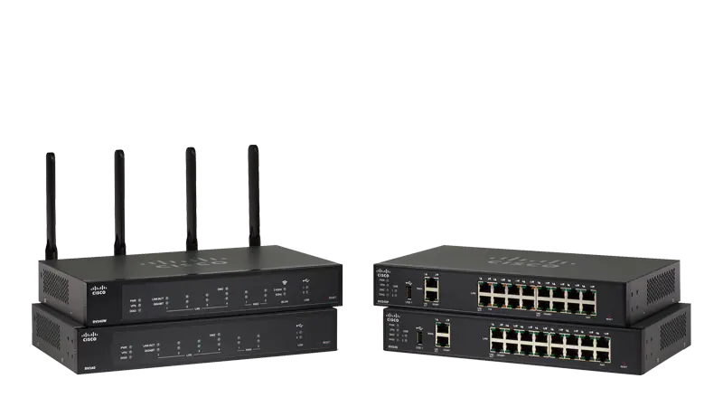
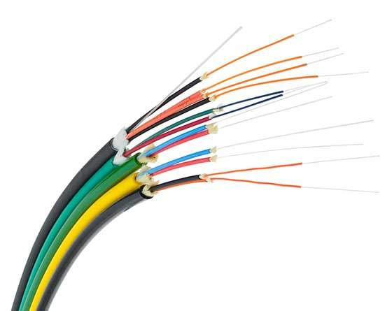
TABLE OF CONTENT
INTRODUCTION
LOGICAL TOPOLOGY DIAGRAM
PHYSICAL TOPOLOGY DIAGRAM
APPROPRIATE DEVICES FOR THE NETWORK
APPROPRIATE MEDIA TYPES FOR THE NETWORK
APPROPRIATE LAN & WAN TECHNOLOGIES FOR THE NETWORK
PROTOCOLS USED AT EACH LAYER ACCORDING TO ISO/OSI
IP ADDRESSING SCHEMA FOR THE NETWORK

Slide 4

IP ADDRESSING SCHEMA FOR THE NETWORK
INTRODUCTION
PROTOCOLS USED AT EACH LAYER ACCORDING TO ISO/OSI
APPROPRIATE LAN & WAN TECHNOLOGIES FOR THE NETWORK
APPROPRIATE MEDIA TYPES FOR THE NETWORK
APPROPRIATE DEVICES FOR THE NETWORK
PHYSICAL TOPOLOGY DIAGRAM
LOGICAL TOPOLOGY DIAGRAM
In today's world, universities play a major role in shaping the lives of students.
XYZ is such a prominent university with actively functioning 7 branches spread across the country.
As a result of the growth of the university network, it has become essential to offer a safe, reliable, and efficient network that can support the needs of over 50,000 users.
This presentation focuses on the proposed network design for XYZ University.

Slide 5
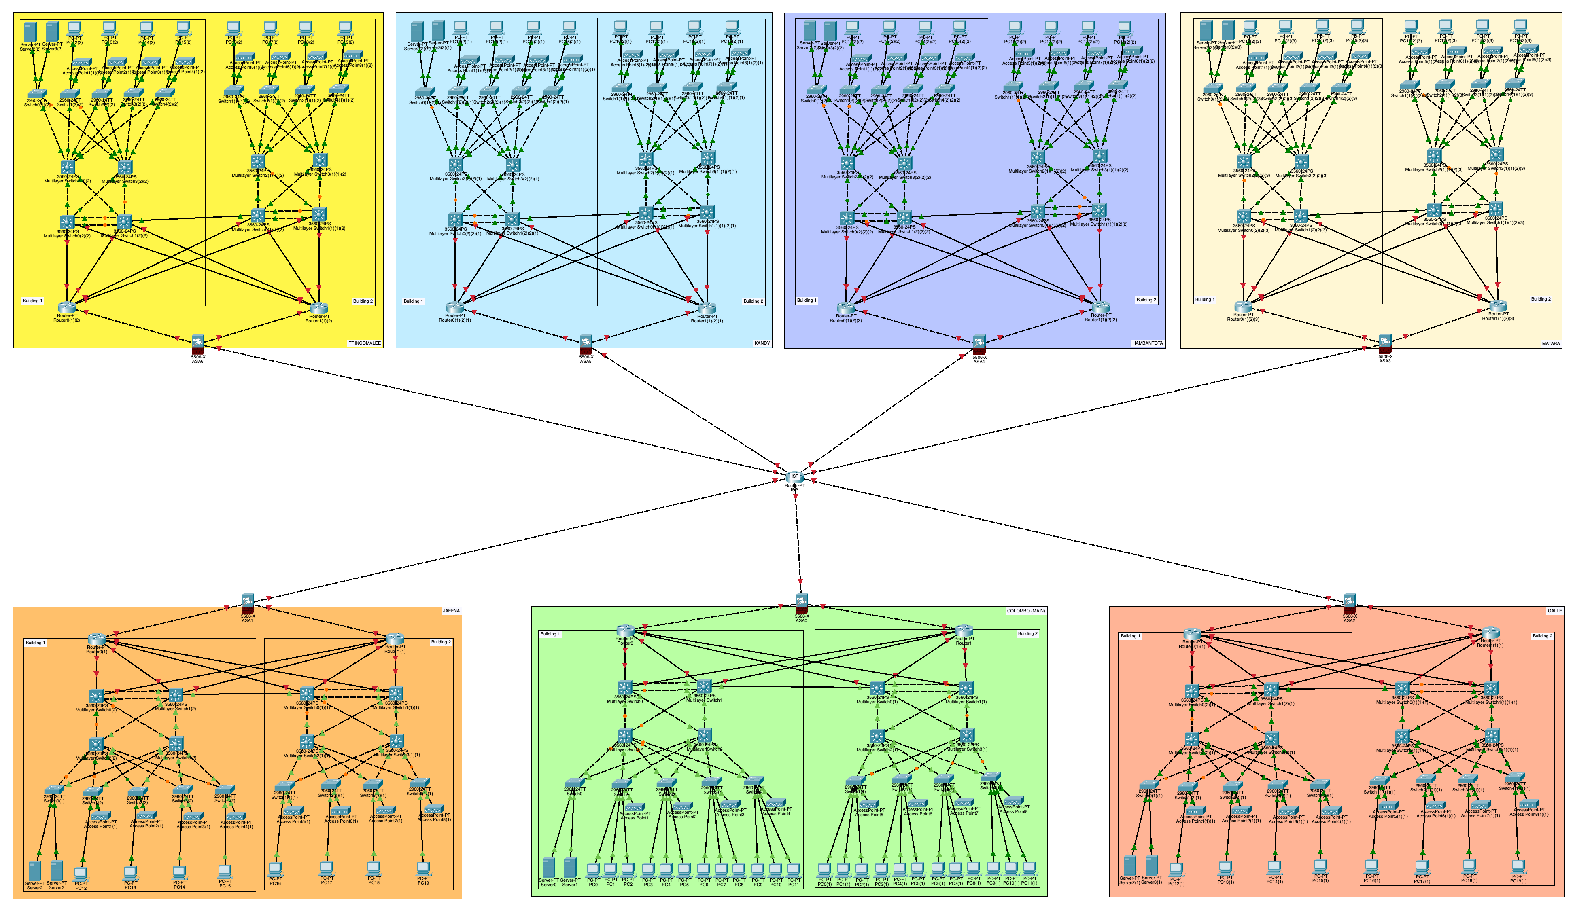
LOGICAL TOPOLOGY DIAGRAM
Logical Topology diagram of
XYZ University

Slide 6
LOGICAL TOPOLOGY DIAGRAM

Slide 7
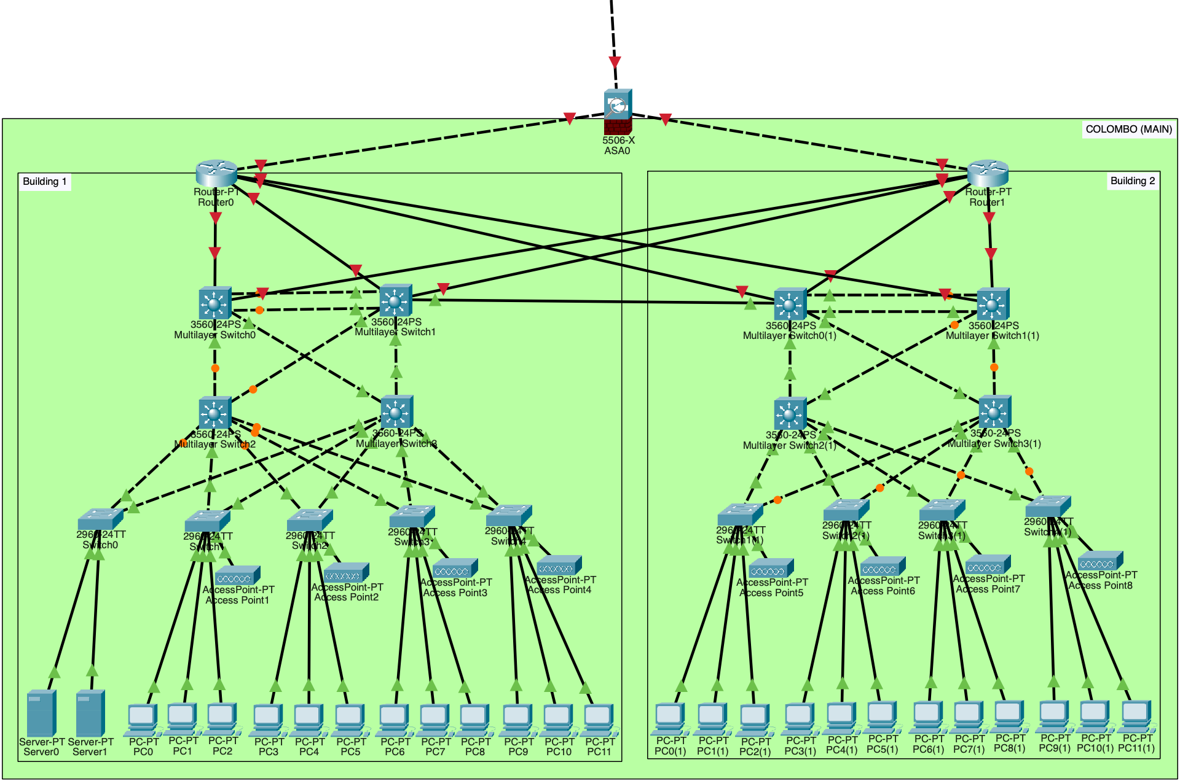
PHYSICAL TOPOLOGY DIAGRAM
LOGICAL TOPOLOGY DIAGRAM

Slide 8
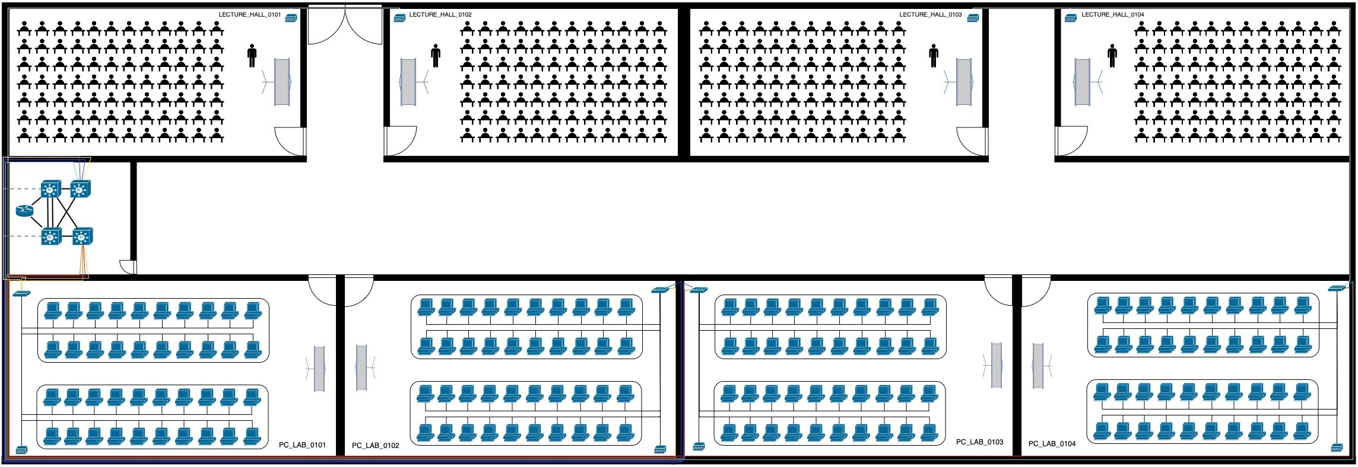
PHYSICAL TOPOLOGY DIAGRAM
Physical Topology of Building 01
Physical Topology of Building 02

Slide 9
APPROPRIATE DEVICES FOR THE NETWORK
PHYSICAL TOPOLOGY DIAGRAM
Physical Topology of Building 02
Physical Topology of Building 01

Slide 10
APPROPRIATE DEVICES FOR THE NETWORK
During the research for the network devices, these were some of the key features that we focused on when selecting the most suitable devices.
Capacity and Performance
Scalability and Flexibility
Security
Reliability and Redundancy
Vendor support/Reputation

Slide 11
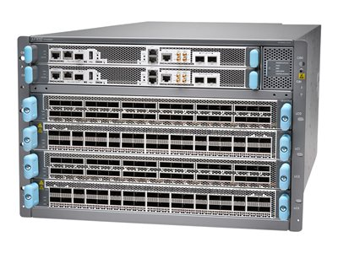
APPROPRIATE DEVICES FOR THE NETWORK
Core Layer
Router - Juniper MX10004
High density
Supports the 400-Gigabit Ethernet (GbE) architecture with inbuilt Media Access Control Security on all ports for point-to-point security.
Supports up to 38.5Tbps of throughput.
Redundancy and Resilience are provided by the power system and the Routing Control Board (RCB)

Slide 12
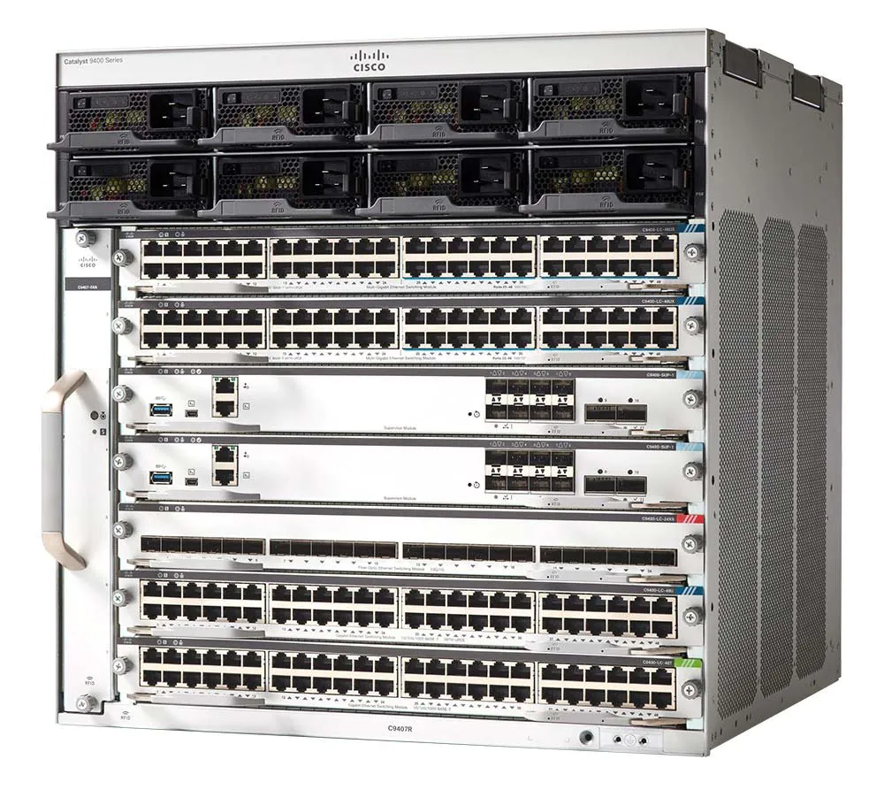
APPROPRIATE DEVICES FOR THE NETWORK
Core Layer
Multilayer Switch – Cisco catalyst C9400
SATA SSD local storage up to 960GB for container-based application hosting.
IPv6 hardware support.
Dual-stack IPv4 and IPv6 capability.
Dual routing (IPv4, IPv6, and multicasting) tables and Layer 2 tables.
Advanced Security
Cisco Encrypted Traffic Analytics (ETA)
AES-2562 support with a strong MACsec-256 encryption algorithm.
Secure Unique Device Identification (SUDI) support for PnP tamper-proof device identity.

Slide 13
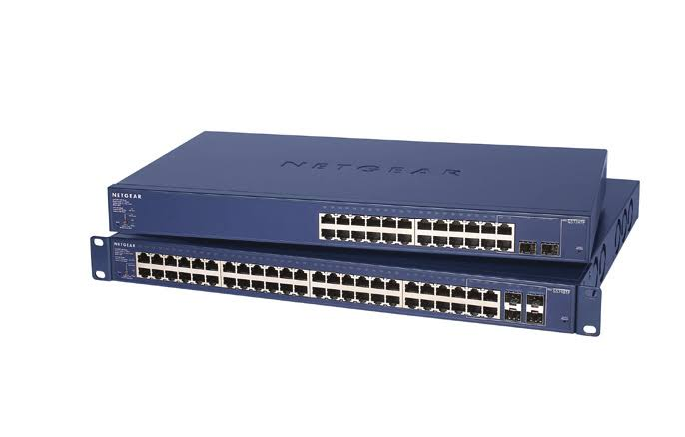
APPROPRIATE DEVICES FOR THE NETWORK
Distribution Layer
Multilayer Switch – Cisco catalyst C9400
Access Layer
Switch – NetGear ProSAFE GS724TP
24 port option.
Smart Switch capability provides critical management functions at the cost of an unmanaged switch.
Performance monitoring, port configuration, VLAN traffic management, port trunking for enhanced bandwidth, and Class of Service (COS) traffic priority are all included.
Easy to set up and use for easy network monitoring and troubleshooting.

Slide 14
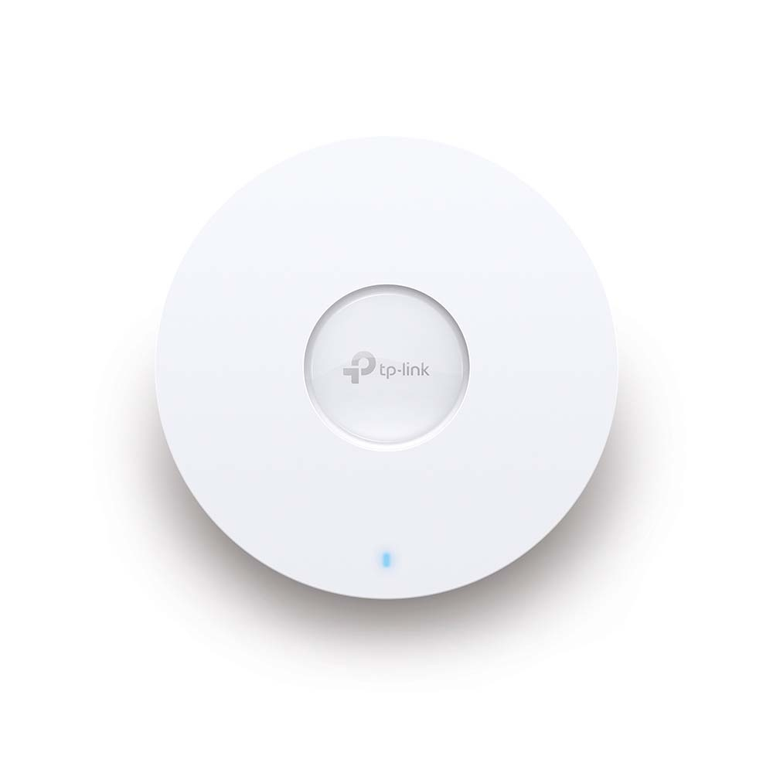
APPROPRIATE DEVICES FOR THE NETWORK
Access Layer
Wireless Access Point – TP-Link Omada EAP 610
Wi-Fi 6 connectivity
1000+ devices linked
Ceiling-mounted APs and Outdoor APs with high density
Use Omada Cloud Software Defined Networking (SDN) to manage every component of the network including APs.
Up to 2.5 Gbps speed.
Seamless roaming.
Easy Installation.

Slide 15
APPROPRIATE DEVICES FOR THE NETWORK
Access Layer
Wireless Access Point – TP-Link Omada EAP 610
Numerous Security Functions
High-Security VPN
Powerful Firewall
IP/MAC/URL filtering
Access Control
Captive Portal
PPSK

Slide 16
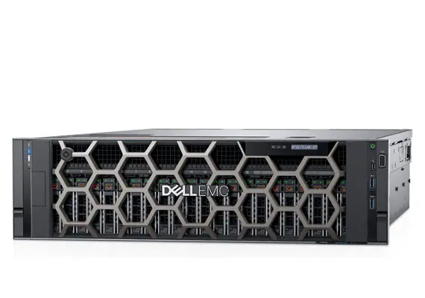
APPROPRIATE DEVICES FOR THE NETWORK
Access Layer
Server – Dell PowerEdge R940 Rack Server
Scalable Architecture.
Automatic Workload adjustment.
Up to 15.36TB of memory.
Up to 12 NVMe Drives for maximum storage performance.
Free up storage space with internal M.2 SSDs.
Eliminate bottlenecks up to 15.36TB
iDRAC9 server lockdown mode protects the server from malicious applications

Slide 17
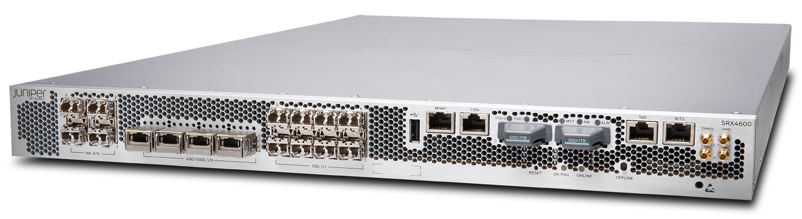
APPROPRIATE MEDIA TYPES FOR THE NETWORK
APPROPRIATE DEVICES FOR THE NETWORK
Security
Firewall – Juniper SRX4600
High Capacity (400GB)
Up to 60 million concurrent sessions
Scalable protection
Provides support for intrusion prevention, application visibility and control, and content security capabilities such as anti-virus, anti-spam, and web filtering.
Advanced threat defense.
Supports enhanced routing and Quality of Service (QoS) at a carrier level.

Slide 18
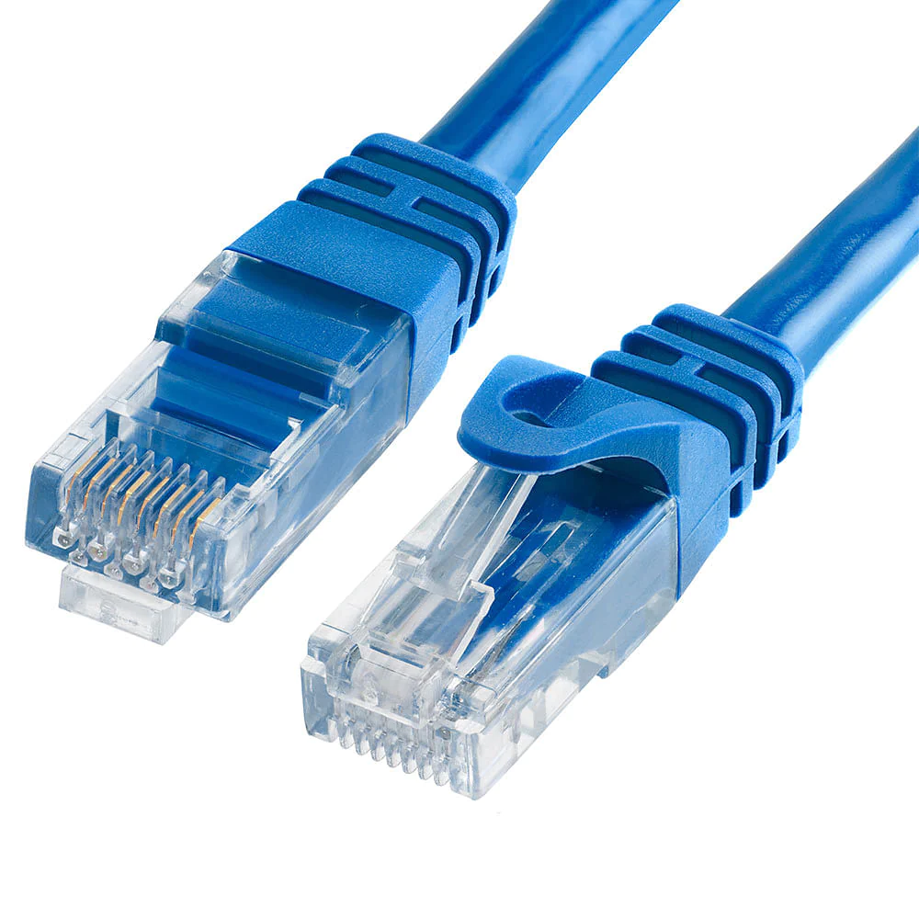
APPROPRIATE MEDIA TYPES FOR THE NETWORK
Ethernet CAT6 cable
Several factors in considering CAT6,
Data transmission speed
Supports up to 10Gbps of data transmission rate over a short distance
Frequencies up to 250 MHz
Transmission distance
Supports 1Gbps data rate up to 100 meters and 10Gbps data rate up to 55 meters consistently.
Reliability
Extremely reliable as it is less probable to be damaged
Cost-effectiveness

Slide 19
APPROPRIATE MEDIA TYPES FOR THE NETWORK
Ethernet CAT6 cable
Connectivity of CAT6 cables over the network,
For the connection between PCs and switches
For the connection between Access points and switches
For the connection between Servers and Switches.
Supports Power over Ethernet (PoE)
PoE enables devices such as wireless access points and IP cameras to power up via the same data transmission cable.

Slide 20
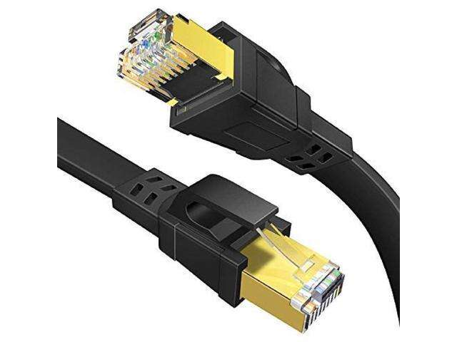
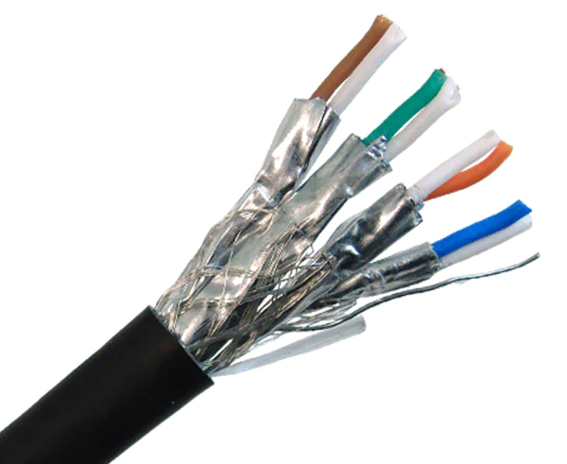
APPROPRIATE MEDIA TYPES FOR THE NETWORK
Ethernet CAT7a cable
A Shielded Twisted Pair (STP) cable that is used in high-speed ethernet-based computer networks
Several factors in considering CAT7a cables,
Data transmission speed
Provides data transmission speed of up to 10Gbps across longer distances
Can handle frequencies of up to 1000 MHz (2 GHz)
Transmission distance
Supports 10Gbps data rate up to 100 meters.
Shielding
Individual pair shielding in addition to overall shielding of the cable

Slide 21
APPROPRIATE MEDIA TYPES FOR THE NETWORK
Ethernet CAT7a cable
Connectivity of CAT7a cables over the network,
For the connection between the distribution layer’s multi-layer switches and the access layer’s switches.
For the connection between the core layer’s multi-layer switches and the distribution layer’s multilayer switches.
For the connection between the core layer multilayer switches for redundancy.

Slide 22
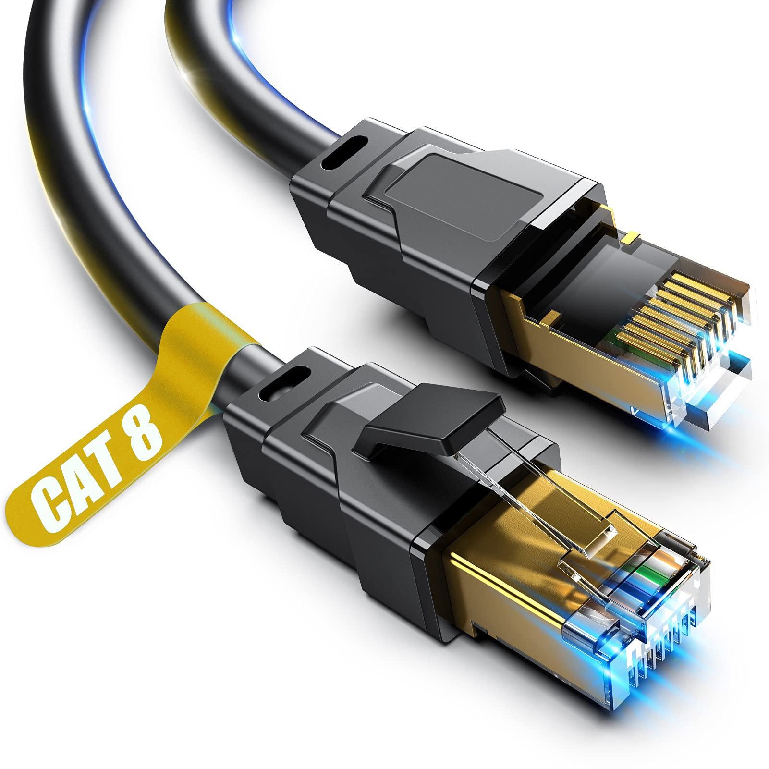
APPROPRIATE MEDIA TYPES FOR THE NETWORK
Ethernet CAT8 cable
Latest Ethernet cable standard
Intended for use in high-speed networking applications.
Several factors in considering CAT8 cables,
Transmission Speed
A data transmission rate of up to 40Gbps across short distances, generally up to 30 meters.
Bandwidth and Frequencies
Capable of handling bandwidths of up to 2000 MHz (2 GHz)
Shielding
Individual pair shielding in addition to overall cable shielding
The multi-layer shielding architecture provides extreme protection against Electromagnetic Interference (EMI) and external noise.

Slide 23
APPROPRIATE MEDIA TYPES FOR THE NETWORK
Ethernet CAT8 cable
Connectivity of CAT8 cables over the network,
For the connection between the Router and the core layer multi-layer switches within the same building

Slide 24
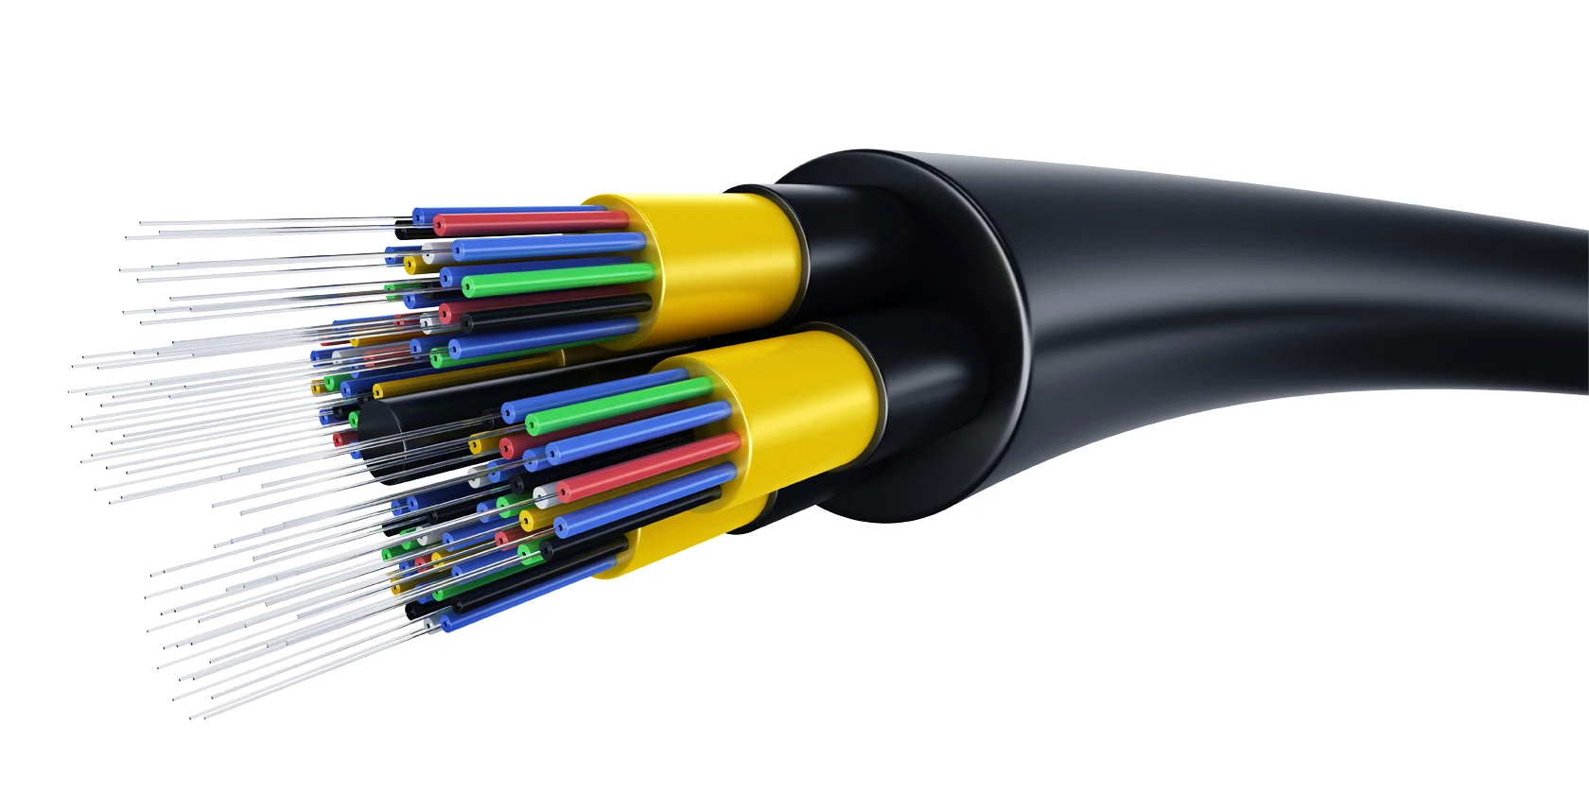
APPROPRIATE MEDIA TYPES FOR THE NETWORK
Fiber Optic Cables
A high-speed transmission medium that uses strands of glass or plastic fiber to transfer data using light signals.
Several factors in considering Fiber Optic cables,
Higher Data Transfer Speed
Rapid data transfer rate ranging from 1Gbps to 400Gbps (the speed depends on the type of fiber optic cable)
Long Transmission Distance
Up to hundreds of Kilometers (Transmission distance can vary depending on the quality of the fiber optic cables, connectors, splicers, and the performance of network equipment)
Reliability
Immunity to Electromagnetic Interference (EMI)
Temperature Fluctuation resistance

Slide 25
APPROPRIATE MEDIA TYPES FOR THE NETWORK
Fiber Optic Cables
Connectivity of Fiber Optic cables over the network,
For the connection between Building 1 Router and Building 2 core-layer multi-layer switches
For the connection between Building 2 Router and Building 1 core-layer multi-layer switches
For the connection between a Core-layer multi-layer switch from Building 1 and a Core-layer multi-layer switch from Building 2

Slide 26
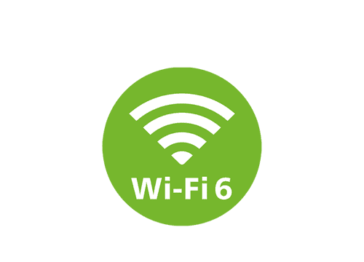
APPROPRIATE MEDIA TYPES FOR THE NETWORK
Wi-Fi 6
Latest Wi-Fi Technology with improved performance, efficiency, and capacity.
Several factors in considering Wi-Fi 6,
Data transmission speed
Supports up to 9.6 Gbps of data transmission rate
Increased Capacity
The ability of simultaneous data transmission to multiple devices, communication between multiple devices
Improved Efficiency
Target Wakeup Time (TWT) technology is used, which allows devices to schedule wake-up times and reduce unnecessary power use.
Enhanced Security
Integrates the latest security standards, for instance, WPA3 Encryption.

Slide 27
APPROPRIATE LAN & WAN TECHNOLOGIES FOR THE NETWORK
APPROPRIATE MEDIA TYPES FOR THE NETWORK
Wi-Fi 6
Connectivity of Wi-Fi 6 over the network,
For the connection between wireless access points and devices such as mobile phones, laptops

Slide 28
APPROPRIATE LAN & WAN TECHNOLOGIES FOR THE NETWORK
LAN Technologies
Ethernet
Provides high-speed wired communication between PCs, Servers, Printers, and other devices throughout the university.
Scalability
Compatibility
Cost-effective
Security
Ease of management
VLANs (Virtual LANs)
VLAN provides logical network segmentation and separates user groups or departments while sharing the same physical infrastructure.
Security
Network management
Resource optimization
Flexibility and Scalability

Slide 29
APPROPRIATE LAN & WAN TECHNOLOGIES FOR THE NETWORK
LAN Technologies
Wi-Fi (Wireless Fidelity)
Wireless LAN involving Wi-Fi technology is vital for providing internet access for students, instructors, and staff.
Mobility
Flexibility
Broad coverage
Evolving standards

Slide 30
APPROPRIATE LAN & WAN TECHNOLOGIES FOR THE NETWORK
WAN Technologies
MPLS (Multi-Protocol Label Switching)
MPLS provides reliable and secure data transmission in addition to including QoS capabilities to prioritize traffic based on significance.
Scalability
Network Segmentation and Security
Inter-operability
Centralized management
Traffic engineering
Leased Lines
Leased Lines provide consistent and predictable connections for high-volume data transfer.
Dedicated and Symmetrical Bandwidth
Geographical flexibility
Offloading Network Management
Cost saving.

Slide 31
APPROPRIATE LAN & WAN TECHNOLOGIES FOR THE NETWORK
WAN Technologies
Internet VPN
VPNs offer secure data transfer as well as a low-cost alternative for linking branch universities.
Cost-effectiveness
Wide Availability
Flexibility
Encryption and Security
SD-WAN
SD-WANs enable centralized management of various WAN connections, boosting performance and security.
Flexible connectivity
Application performance optimization
Centralized management
Cost saving.

Slide 32
PROTOCOLS USED AT EACH LAYER ACCORDING TO ISO/OSI
APPROPRIATE LAN & WAN TECHNOLOGIES FOR THE NETWORK
WAN Technologies
Cloud-based Services
Cloud-based services can alleviate network congestion by offloading traffic from the university’s WAN
Scalability and Elasticity
Geographical flexibility
Offloading network management
Cost saving

Slide 33
PROTOCOLS USED AT EACH LAYER ACCORDING TO ISO/OSI
Application Layer
HTTP and HTTPS
Browsing protocols which offer a reliable, fast connection to access university-based websites.
Guarantees safe connection across web services.
SMTP and SMTPS
Facilitates safe email communication within the institution.
Ensures reliable email and message delivery across university networks.
FTP and SFTP
Supports tasks by enabling reliable file and data communication.
Facilitates secure file transfer within the university network.
Web conferencing protocols
Allows remote learning and real-time communication, including online meetings.

Slide 34
PROTOCOLS USED AT EACH LAYER ACCORDING TO ISO/OSI
Presentation Layer
ASCII
Widely used for represntation of text based information including email, web pages.
UNICODE
Essential for the university network to provide multilingual content and communication facilities.
SSL (Secure Socket Layer)
Provides secure and encrypted communication channels.
Ensures the integrity and confidentiality of data and is utilized in programs like online learning environments

Slide 35
PROTOCOLS USED AT EACH LAYER ACCORDING TO ISO/OSI
Presentation Layer
RDP (Remote Desktop Protocol)
Enables remote access to desktops or apps hosted on servers.
Used by students and staff who need remote access to specialized software.
GIF and JPEG
These are a few of the most typical picture file types.
JPEG is the best format for displaying high-quality photographs.
GIF is appropriate for tiny, animated graphics.
Makes it possible for the university to transmit and show visual materials like course slides.
Session Layer
SIP (Session Initiation Protocol)
Used for initiation, modification, and termination of multi-media sessions including voice and video calls, IM, and conferencing.

Slide 36
PROTOCOLS USED AT EACH LAYER ACCORDING TO ISO/OSI
Session Layer
ASP (AppleTalk Session Protocol)
AppleTalk network uses the protocol.
It may be relevant in legacy systems or certain contexts inside the university network.
Although being less frequent in contemporary networks
RTP (Real-time Transmission Protocol)
A session layer protocol created solely for the real-time transfer of audio and video data across IP networks.
Facilitates the distribution of multimedia material across the university network, including online courses, video conferences, and live streaming.
Transport Layer
TCP (Transmission Control Protocol)
A reliable, connection-oriented protocol that offers flow control and error detection.
Guarantees information transfer between applications on the university network.

Slide 37
PROTOCOLS USED AT EACH LAYER ACCORDING TO ISO/OSI
Transport Layer
UDP (User Datagram Protocol)
A lightweight, connectionless protocol that provides little overhead and quick transmission.
Suitable for university-based applications like video conferencing and online courses.
MTCP (Multi-path TCP)
Permits the concurrent use of many network routes for load balancing and fault tolerance.
For a university with several branches, MTCPs can efficiently use the network links available to provide high-speed connectivity.
SCTP (Stream Control Transmission Protocol)
A trustworthy message-oriented transport protocol which was created to overcome TCP and UDP shortcomings.
Supports many streaming channels. Applications like networked multi-media services on the university network is benefitted from this protocol.

Slide 38
PROTOCOLS USED AT EACH LAYER ACCORDING TO ISO/OSI
Network Layer
IPv4
The most popular network layer protocol which serves as the basis for internet access.
Supports the functionality of multiple users and devices simultaneously.
Within the university network, IPv4 offers dependable and fast communication.
IPv6
Offers several enhancements over IPv4.
Includes more advanced security measures and a larger address space.
Each device on the university network will have access to a distinct address with the use of IPv6.
OSPF (Open Shortest Path First)
The shortest path between nodes is efficiently determined by this link-state routing protocol.
This offers a hierarchical architecture, making it scalable in maintaining routing information across numerous campuses, making it appropriate for a big university network.

Slide 39
PROTOCOLS USED AT EACH LAYER ACCORDING TO ISO/OSI
Network Layer
Border Gateway Protocol
An external gateway protocol that allows computers to communicate routing information.
Allows for communication with external networks and safe routing between campuses and ISPs in a country-wide, major university network.
DHCP (Dynamic Host Configuration Protocol)
Used to assign IP addresses to network devices automatically.
ICMP (Internet Control Message Protocol)

Slide 40
PROTOCOLS USED AT EACH LAYER ACCORDING TO ISO/OSI
Data Link Layer
Ethernet
The most popular and versatile data link layer protocol.
For local area networks (LANs) to handle many users and devices on each campus, it delivers dependable and fast connection.
Because of Ethernet’s scalability and interoperability with a wide range of network topologies, the network may be simply expanded as the institution grows.
PPP (Point-to-Point Protocol)
A data link layer protocol that is frequently used for point-to-point connections.
Offers procedures for authentication and encryption, assuring the confidentiality and integrity of data sent across the network.
PPP can link the university network to external networks or provide specialized connections across campuses.

Slide 41
PROTOCOLS USED AT EACH LAYER ACCORDING TO ISO/OSI
Data Link Layer
ATM (Asynchronous Transmission Mode)
A high-speed switching technology that operates at the physical and data connection layers.
Provides dependable and efficient transfer of data, phone, and video information throughout the university network.
Frame Relay
Frame Relay provides virtual circuit-based connections that make it possible to manage traffic, allocate capacity, and transmit data effectively.

Slide 42
IP ADDRESSING SCHEMA FOR THE NETWORK
PROTOCOLS USED AT EACH LAYER ACCORDING TO ISO/OSI
Physical Layer
Fiber Optic Cabling
Fiber optic connections allow high-speed and secure data transfer across vast distances.
Appropriate for a large university network with various campuses network because they offer dependable and high-bandwidth communication.
Ensure effective data transfer for the university's many applications and services because of their low signal attenuation, resistance to electromagnetic interference, and high data capacity.
Wi-Fi
A commonly used wireless technology that connects devices to the university network and operates in the 2.4 GHz and 5 GHz frequency ranges.
Users may access the network from multiple points across each campus because of its mobility.
Wi-Fi supports high-speed transmission rates and provides dependable coverage by installing access points that are strategically scattered around the campuses.

Slide 43
IP ADDRESSING SCHEMA FOR THE NETWORK
The IP Address assigned for the university network is 172.18.0.0/16.
A Class B private IP address.
The capability of connecting up to 65,536 hosts.
The desired assignable IP address range for each branch,
Branch | Required number of IPs | Required number of bits
Colombo (Main) | 15,000 | 14
Kandy | 8,000 | 13
Galle | 8,000 | 13
Matara | 8,000 | 13
Hambantota | 8,000 | 13
Trincomalee | 8,000 | 13
Jaffna | 8,000 | 13

Slide 44
IP ADDRESSING SCHEMA FOR THE NETWORK
Designated IP Addressing schema for the university network.
Branch | Network Address | First usable IP address | Last usable IP address | Broadcast address | Subnet mask
Colombo (Main) | 172.18.0.0/18 | 172.18.0.1 | 172.18.63.254 | 172.18.63.255 | 255.255.192.0
Kandy | 172.18.64.0/19 | 172.18.64.1 | 172.18.95.254 | 172.18.95.255 | 255.255.224.0
Galle | 172.18.96.0/19 | 172.18.96.1 | 172.18.127.254 | 172.18.127.255 | 255.255.224.0
Matara | 172.18.128.0/19 | 172.18.128.1 | 172.18.159.254 | 172.18.159.255 | 255.255.224.0
Hambantota | 172.18.160.0/19 | 172.18.160.1 | 172.18.191.254 | 172.18.191.255 | 255.255.224.0
Trincomalee | 172.18.192.0/19 | 172.18.192.1 | 172.18.223.254 | 172.18.223.255 | 255.255.224.0
Jaffna | 172.18.224.0/19 | 172.18.224.1 | 172.18.255.254 | 172.18.255.255 | 255.255.224.0

Slide 45






THANK YOU
Vimeth Athukorala
IT22319456
Thinuka Muthukumaran
IT22310132
Stephi Fonseka
IT22912770
Amadi Kariyawasam
IT22927170
Naveen Dilshan
IT22360632

